Slide 1
COVID-19 and its
Clinical Spectrum Prediction
using
Bayesian Networks
Presented By: Sanchit Kumar, Boroju Arthik (ID_29)

Slide 2
Outline
PROBLEM STATEMENT AND OBJECTIVE
METHOD
DATASET AND TOOLS USED
EXPERIMENT RESULTS
CONCLUSION

Slide 3
Problem Statement
The Covid19 pandemic has put medical professionals under the immense pressure and all available resources are not enough. More than 155 Million people got infected so far worldwide.
It is practically not feasible now days to get the medical resources such as getting oxygen cylinders, medicines, ICU, semi-ICU or even general ward bed’s at the hospital due to heavy load on the clinical spectrum.
People are also very uncertain about their future condition that if they catch virus, so what kind of treatment they will likely to get on the basis of their comorbidities.
We will be using the concept of Bayesian Network with real world dataset of Covid19, to predict the clinical spectrum of healthcare.
It will help us to figure out how much load on regular ward in future, will there be requirement of intensive care such as ventilator, ICU or moderate car such as oxygen supply enabled beds etc. The predicted Bayesian network will work on the basis of the comorbidities that increase the probability of being admitted to ICU.

Slide 4
Objective
To develop a bayesian network (based on probabilistic dependences) that can accurately predict whether a suspected case will take an Intensive Care Unit (ICU), semi-intensive care (say oxygen support beds) of a hospital during the current pandemic.
Healthcare professionals will be having an idea of whether a person will require intensive care in the immediate future to better allocate their resources in moments of great strain. So it will also help them predict the load on their infrastructure.

Slide 5
Method
We are using Bayesian Network for making the predictive decision on the basis of the probabilities.
Bayesian network is a probability graph model which is joint probability distribution over set of random variables.
The important characteristics of the Bayesian Network in the memory gain by making probabilistic reasoning.
Memory gain become important when we deal with the wide dataset.

Slide 6
Dataset Used
Anonymised medical data from patients that were tested for Covid-19 at the Hospital Israelita Albert Einstein in São Paulo, Brazil.
Python Library Used: pyAgrum (for bayesian network)

Slide 7
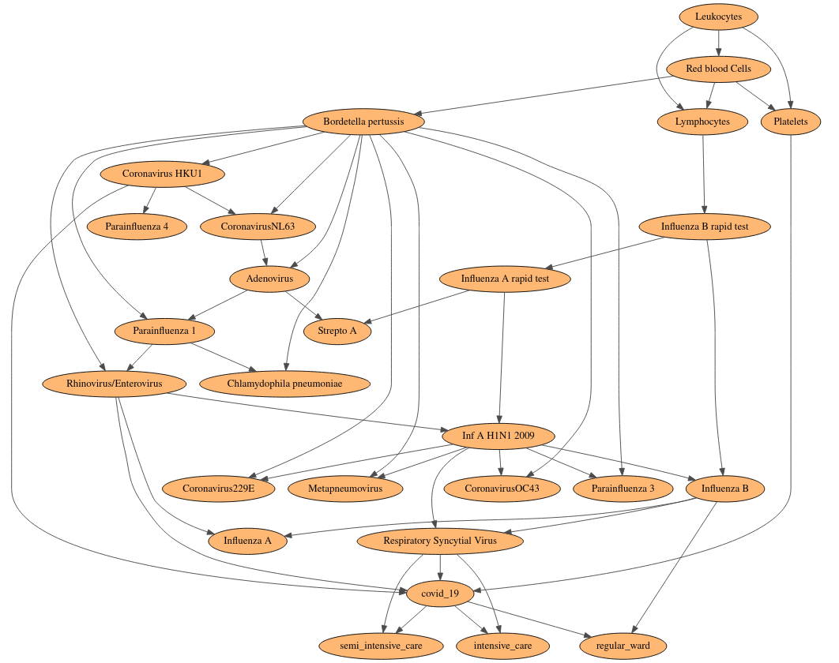
BAYESIAN
NETWORK
OF
PROPOSED
MODEL

Slide 8
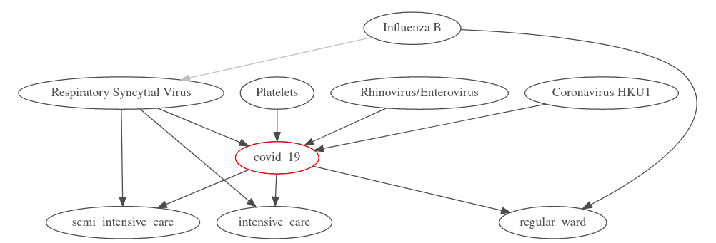
Markov Blanket for Covid19

Slide 9
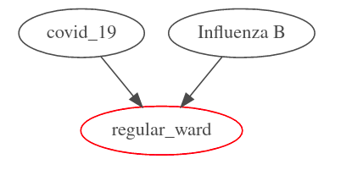
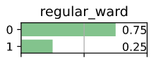
Experimental Results
All experiments conducted on some fixed comorbidities for all Regular ward, intensive care and semi-intensive care. Markov blanket, and posterior probability given below.
Regular ward
 |  | Regular ward
COVID-19 | Influenza B | 0 | 1
0 | Not detected | 0.9713 | 0.0287
 | detected | 0.9983 | 0.0017
1 | Not detected | 0.7495 | 0.2505
 | detected | 0.9286 | 0.0714
Regular Ward Markov Blanket
Regular Ward Probability Table
Regular ward posterior probability

Slide 10
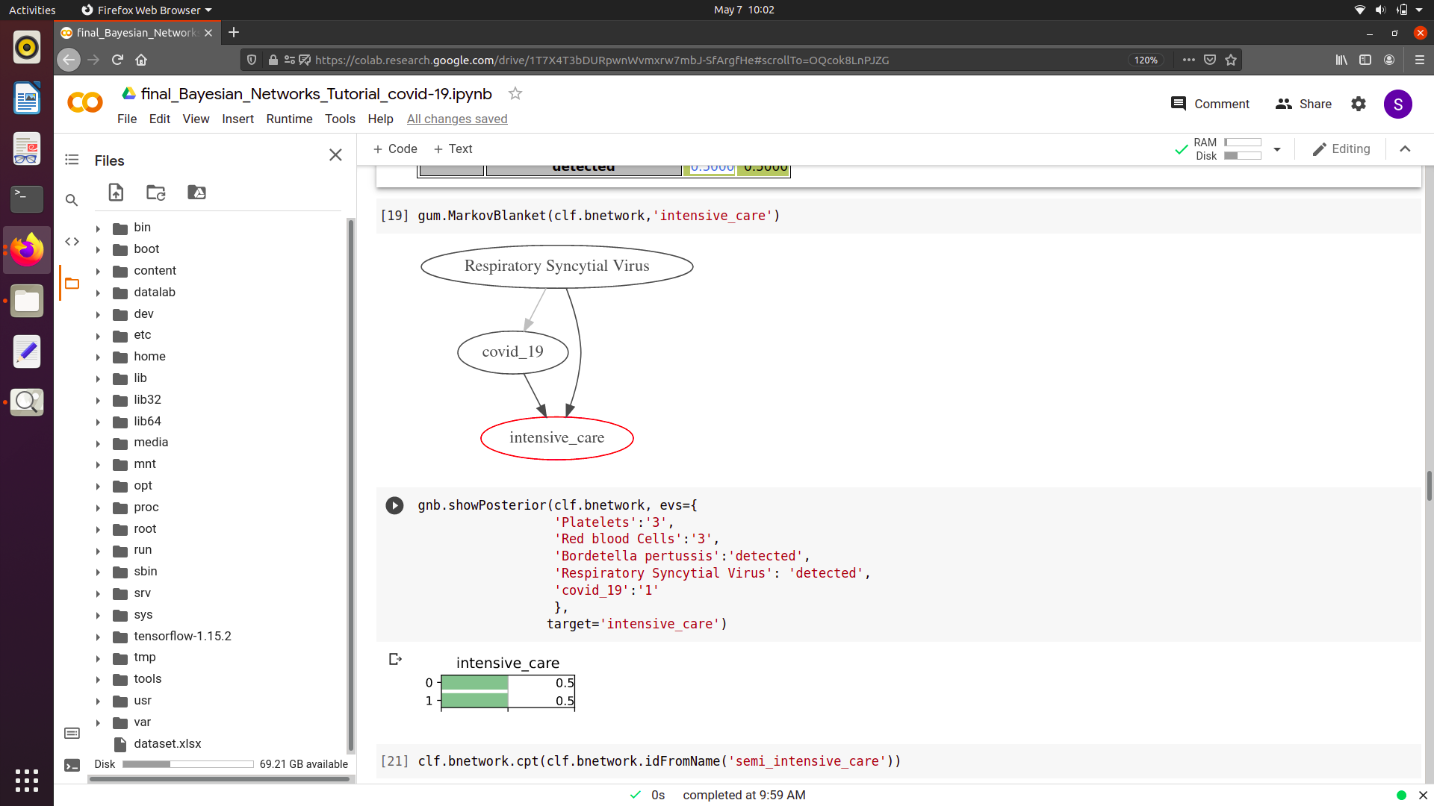
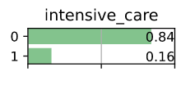
Experiment Results(cont.)
Posterior, Markov Blanket & Probability Table
2. INTENSIVE CARE UNIT
 |  | Intensive Care Unit (ICU)
COVID-19 | Respiratory Syncytial Virus | 0 | 1
0 | Not detected | 0.9851 | 0.0149
 | detected | 0.8396 | 0.1604
1 | Not detected | 0.9620 | 0.0380
 | detected | 0.5000 | 0.5000
Requirement of ICU (if covid positive)
Markov Blanket Intensive Care
Requirement of ICU (if covid negative)
Intensive Care Unit Probability Table

Slide 11
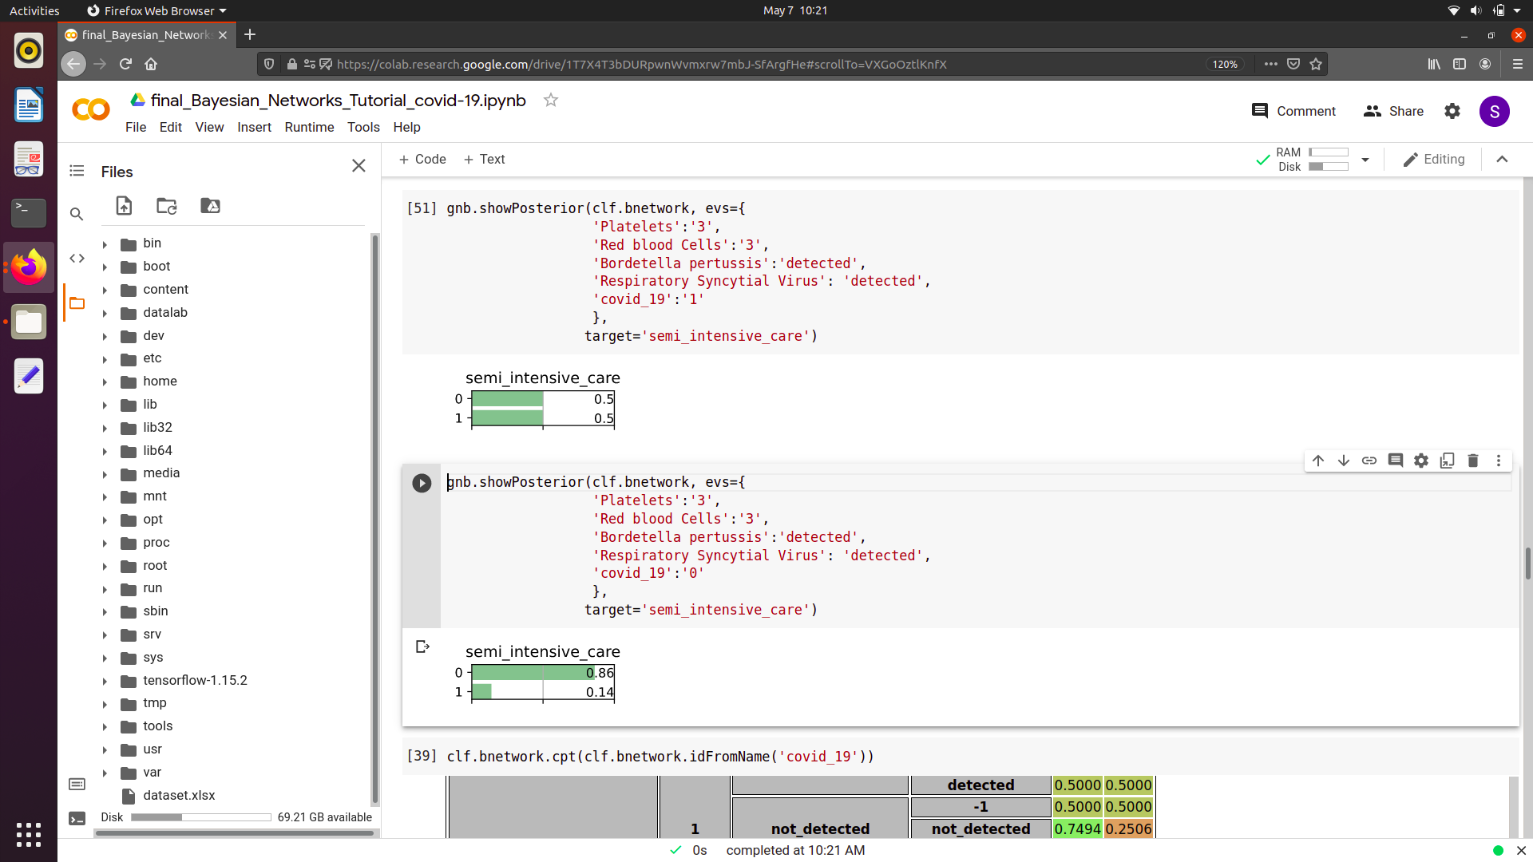
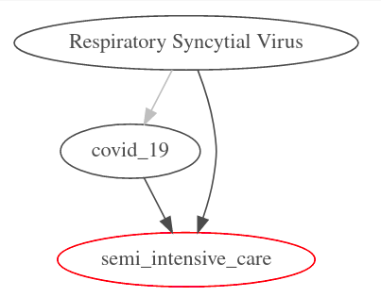
Experiment Results(cont.)
Posterior, Markov Blanket & Probability Table
3. SEMI-INTENSIVE CARE UNIT
 |  | Semi Intensive Care Unit (S-ICU)
COVID-19 | Respiratory Syncytial Virus | 0 (S-ICU not required) | 1 (S-ICU not required)
0 | Not detected | 0.9783 | 0.0217
 | detected | 0.9620 | 0.0380
1 | Not detected | 0.8623 | 0.1377
 | detected | 0.5000 | 0.5000
Requirement of Semi-ICU (if covid positive)
Markov Blanket Semi-Intensive Care
Requirement of Semi-ICU (if covid negative)
Semi-Intensive Care Unit Probability Table

Slide 12
Conclusion
From the purposed probability bayesian network, we can effectively predict the clinical spectrum of covid19 and effectively manage the resources and save the lives of the people during this pandemic.
This model will allow us to predict the patient’s need in the near future whether he/she will require the ICU, semi-ICU, general ward etc. facility on the basis of various comorbidities.
Patient can also use this model for their self analysis so than they can become more careful for their actions on the basis of their risk category.

Slide 13
THANK
YOU

